Slide 1
SPRINT 2
Muhammad David Hilmawan
18102023

Slide 2
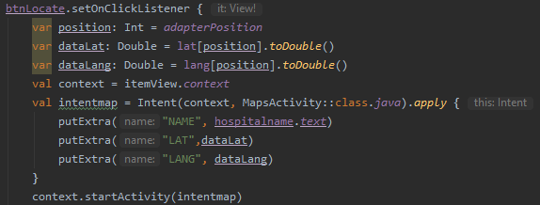

Intent

Slide 3
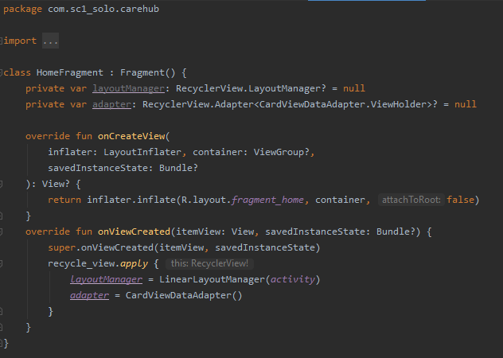
Fragment

Slide 4
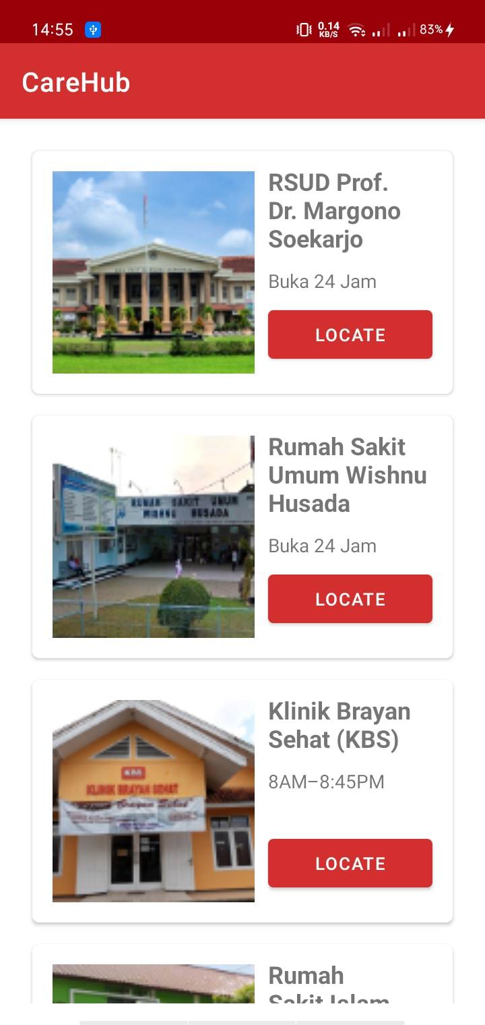
RecycleView

Slide 5
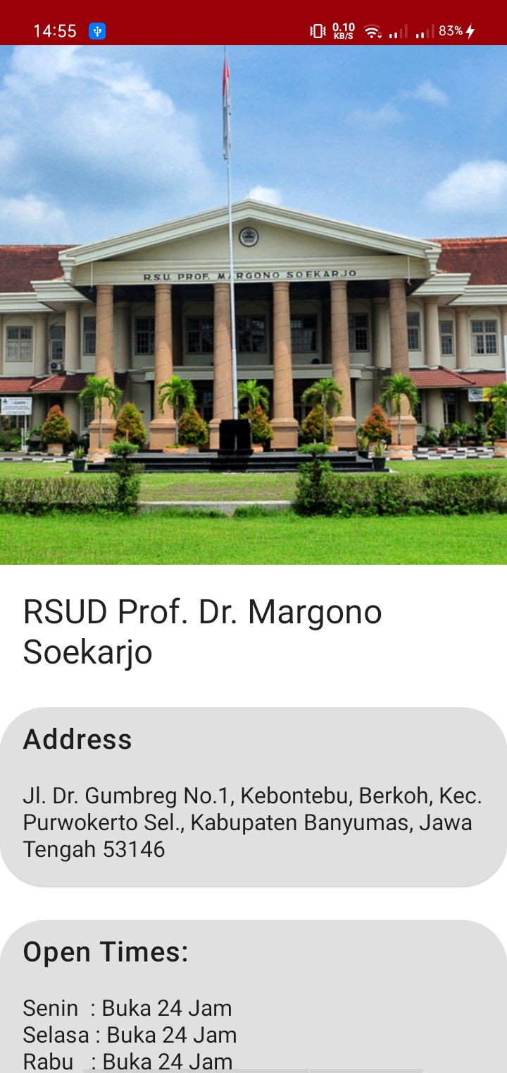
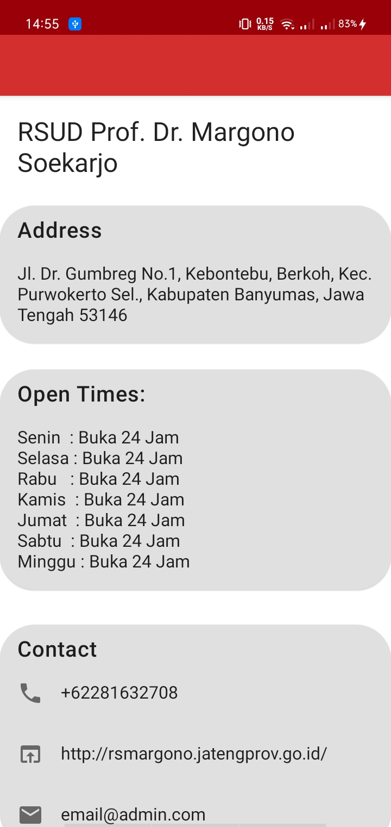
Scrolling Activity

Slide 6
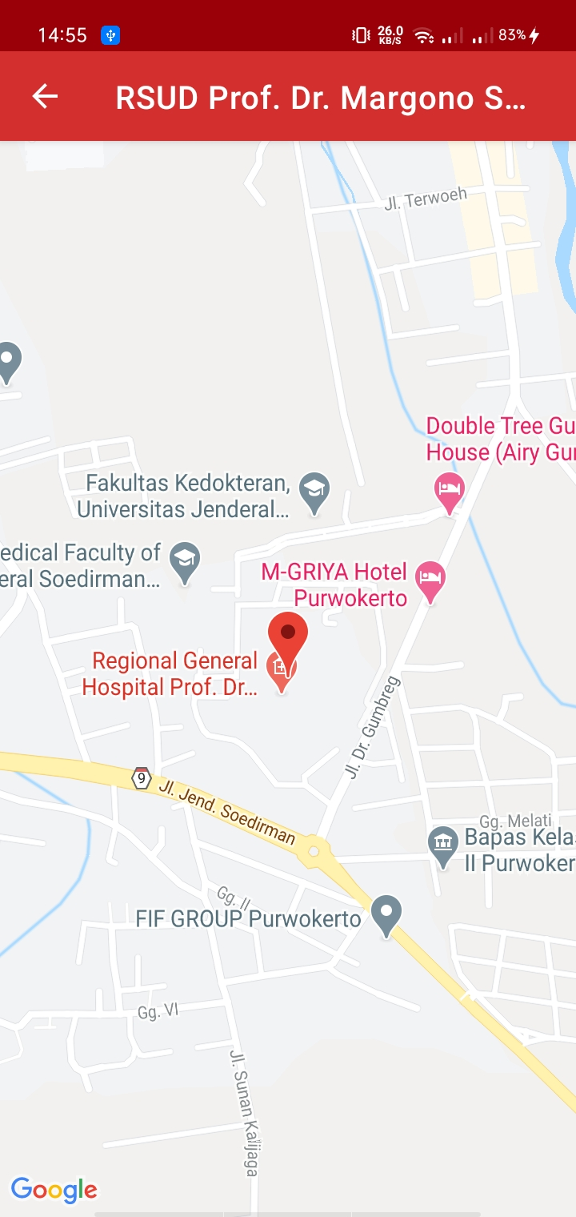
Google Maps Activity

Slide 7

Splash Screen

